Slide 1
Operating System Lab # 01
Prepared by : Engr. Rahemeen Khan

Slide 2
Policies
Attendance
Students are expected to attend all Labs. If a student misses 3 sessions from lab or 10 hours in total without an acceptable reason, the student will be barred from the final lab exams.
Code of Conduct
The assignments, quizzes and exams need to be done individually.
Project Deadlines
Copying of another student's work or code, even if changes are subsequently made, is inappropriate, and such work or code will not be accepted. However, in case of group assignments, copying of another group’s work or code, even if changes are subsequently made, is inappropriate, and such work or code will not be accepted.

Slide 3
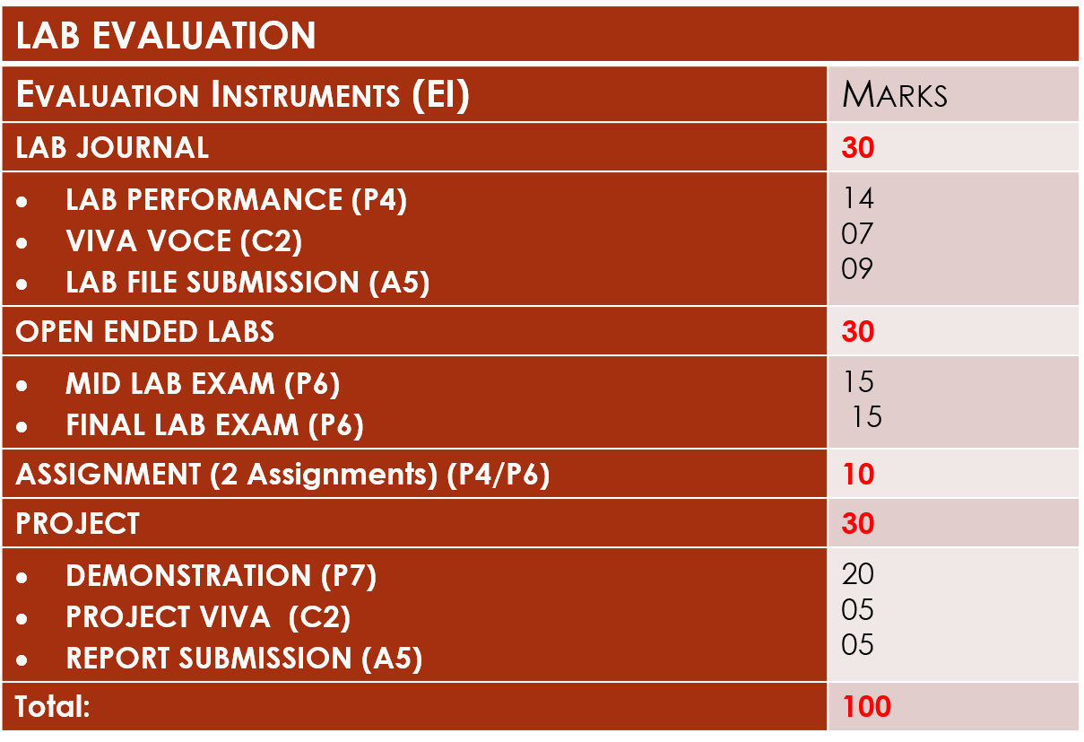

Slide 4
Introduction to Linux
Linux is an operating system that was first started out of curiosity by Linus Torvalds
In the meantime, hundreds of developers are developing it further.
Linux was inspired by UNIX, an operating system developed in the 1970s at AT&T Bell Laboratories that soon became the preferred system for research and technology.
For the most part, Linux uses the same concepts and basic ideas as UNIX, and it is easy to get UNIX software to run on Linux, but Linux itself does not contain UNIX code, but is an independent project.
Unlike Windows and OS X, Linux is not backed by an individual company whose economic success hinges on the success of Linux.
Linux is “freely available” and can be used by anyone, even commercially.
This together with the fact that by now Linux no longer runs just on PCs, ranging from telephones (the most popular smartphone operating system, Android, is a Linux offshoot) to the largest mainframes (the ten fastest computers in the world are all running Linux)

Slide 5
Linux Directory Structure
A Linux system consists of hundreds of thousands of files.
In order to keep track, there are certain conventions for the directory structure and the files comprising a Linux system, the Filesystem Hierarchy Standard (FHS).
Figure 1: LINUX Directory Structure

Slide 6
The root directory of the entire file system hierarchy.
/bin It contains the essential command binaries that need to be available in single user mode; for all users. These files that are essential for the correct operation of the operating system.
/home This is where users home directories are stored containing saved files, personal settings, etc.
/lib Essential libraries.
/etc Various system configuration files are stored here.
/dev This contains various devices as files, e.g. hard disk, CDROM drive etc.
/usr Is one of the important directories in the system as It contains all the user binaries, i.e. contains the majority of user utilities and applications.
/proc Virtual filesystem providing process and kernel information as files.
/root This is the root (administrator) user's home directory.
/var Variable files whose content is expected to continually change during normal operation of the system, such as logs, spool files, and temporary e-mail files.

Slide 7
/tmp Temporary files. Often not preserved between system reboots, and may be severely size restricted.
/usr/src/linux Contains the source code for the Linux kernel. It contains user documentation, games, graphical files, libraries (lib), etc.

Slide 8
Linux Terminal and Shell
Besides the graphical interface, all three systems also offer a way to use a “command line” to input textual commands which the system then executes.
With Windows and OS X, this feature is mostly used by system administrators, while “normal” users tend to shun it.
With Linux, on the other hand, the command line is much less disliked, which may have to do with its descent from the scientific/technical UNIX philosophy.
Users cannot communicate directly with the operating system kernel. This is only possible through programs accessing it via “system calls”.
This is the task of the shell, a special user program that reads commands from the keyboard and interprets them as commands to be executed.

Slide 9
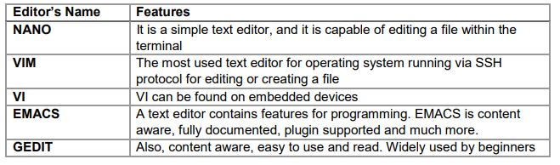
Editors in Linux
The following are the top five widely used editors for Linux:

Slide 10
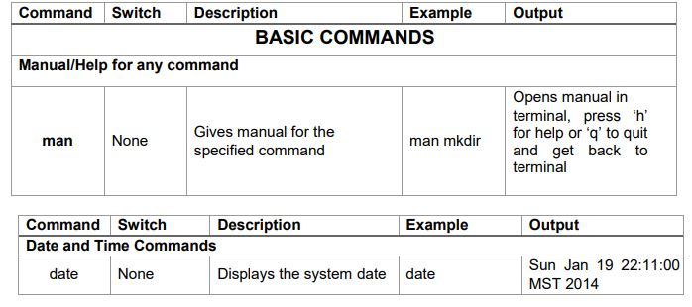
Basic Commands in Linux

Slide 11
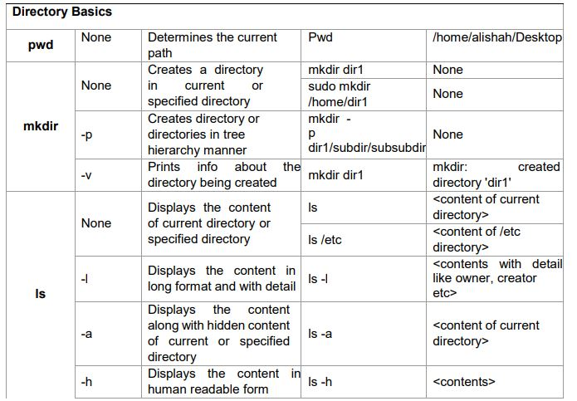

Slide 12
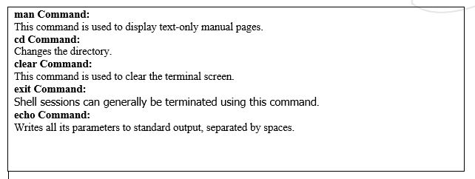

Slide 13
The C Language in Linux
The C programming language is an excellent choice for beginning programmers. This is because it is relatively simple, yet powerful and widely used.
It is also because C is the basis for many other programming languages, and thus experience gained with C can be applied to those languages as well.
In addition, experience with C is useful for obtaining an in-depth understanding of Linux and other UNIX-like operating systems, because they are largely written in C.
Every C program has exactly one function named main().

Slide 14
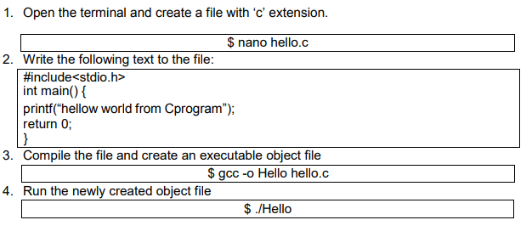
Compile C Program on Linux

Slide 15
Lab Activity
Question # 01:
By using the command line shell interface, practice the commands given in this lab. Write briefly about the usage of each command.
Question # 02:
By using gedit, open a text editor and write the C program That print your name. Save the written file as “name.c”. In order to compile and execute the output file, do the following:
$ gcc - o name name.c
$ ./name
Question # 03:
Make changes within the above program to display a new output text as given below. Write down the developed program.
Hello World! I am studying Operating Systems.
My name is “Enter your name”.
My registration number is “Enter your registration number”.
I belong to Bahria University Karachi Campus.

